Slide 1

Parts of speech tagging

Slide 2
WHY Parts of speech tagging Required?
3 main techniques:
Rule based
Machine learning/AI (MARKOV and other models)
Transformation-based
used in Machine learning and AI for various purposes
Parsing
Translation
Text to speech
Word sense
Disambiguation

Slide 3
Parts of Speech
ADJECTIVE
ADVERB
ADPOSITION
CONJUNCTION
Describes, modifies or gives more information about a noun or pronoun.
Modifies a verb, an adjective or another adverb. It tells how(often) where, when.
Joins two words, ideas, phrases together and shows how they are connected.
Cover term for
prepositions and
postpositions
DETERMINER
NOUN
PRONOUN
Modifies nouns or noun phrases and express the reference of the noun phrase in context.
Name of a person, place, thing or idea.
NUMERICAL
A pronoun is used in place of a noun or noun phrase to avoid repetition.
Functions as a determiner, adjective or pronoun , that expresses a number and a relation to the number.
PARTICLE
VERB
FOREIGN WORD
PUNCTUATION MARK
Associated with another word or phrase to impart meaning.
Shows an action or a state of being.
Used restrictively
Non-alphabetical characters.

Slide 4
Universal Tag set, 12 tags
ADJ (adjective)
ADV (adverb)
ADP (ad position)
CONJ (conjunction)
DET (determiner)
NOUN
NUM (number)
PRON (pronoun)
PRT (particle)
VERB
X (foreign word)
. (punctuation mark).

Slide 5
Ambiguity Of Parts of speech
Oilcloth only costs about 79-cents a yard for the very best
Higher costs of distribution generally .
The DET inside NOUN of ADP their DET place NOUN was VERB full ADJ of ADP new ADJ furniture NOUN
Once ADV inside ADV , . keep VERB your DET eyes NOUN open VERB
NOUN ADV VERB ADV NOUN DET NOUN ADP DET ADV ADJ
ADJ NOUN ADP NOUN ADV .

Slide 6
ALGORITHMS USED
MARKOV(HMM)
1
BAYES THEORM
2

Slide 7
Probabilities
Transition
P(Si+1|Si)
Emission
P(Wi|Si)
Transition probabilities:
P(Si+1|Si) = P(Si+1 , Si)/P(Si)
Probability of two POS tags appearing in sequence, that is P(Si+1 , Si)
Example [noun-adj], P(noun,adj) is the probability of noun-adj pair appearing and is stored as the transition probabilities.
Emission probabilities:
P(Wi/Si):
P(Word/Part Of Speech) = probability of word given a part of speech
P(found/VERB) = emissionProbs["VERB"]["found"]

Slide 8

Hidden Markov Model (Viterbi)
initial probability $p(t_{1})$

Slide 9
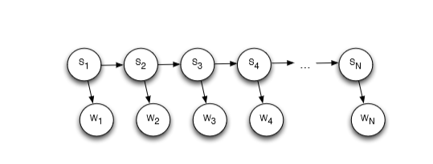
Hidden Markov Model(Viterbi)
Each state is dependent on the previous state
So for sequence "s1,s2,s3,s4,....,sn"
Probability P(Si = si|W) leads to maximum
P(S1,S2,S3,S4,....,Sn/W1,W2,W3,...,Wn) = P(W1/S1)*P(S1)*P(W2/S2)*P(S2/S1)....*P(Wn/Sn)*P(Sn/Sn-1)
For every state at position t, find the max of previous states' probability times the transition probability from the precious state to current state and multiply with emission probability of the current state
maxPaths[position][POS] = maxPaths[position-1] [prevStateLeadingToMax] + "=>" + POS

Slide 10
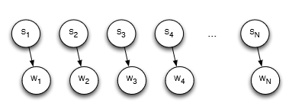
Bayes Approach
Assumption is that each POS at a give position is independent of any other positions.
That is, P(S1,S2,S3,S4,....,Sn/W1,W2,W3,...,Wn) =P(W1/S1)*P(S1)*P(W2/S2)*P(S2)....*P(Wn/Sn)*P(Sn)
So at every ith position, we find out the "si" leading to the highest probability of P(Si = si/W) and output the sequence of the labels.

Slide 11
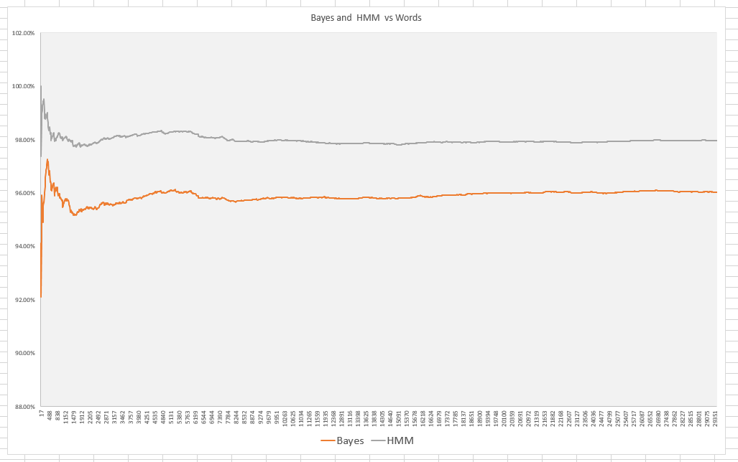
Graph: HMM v/s Bayes for Words

Slide 12
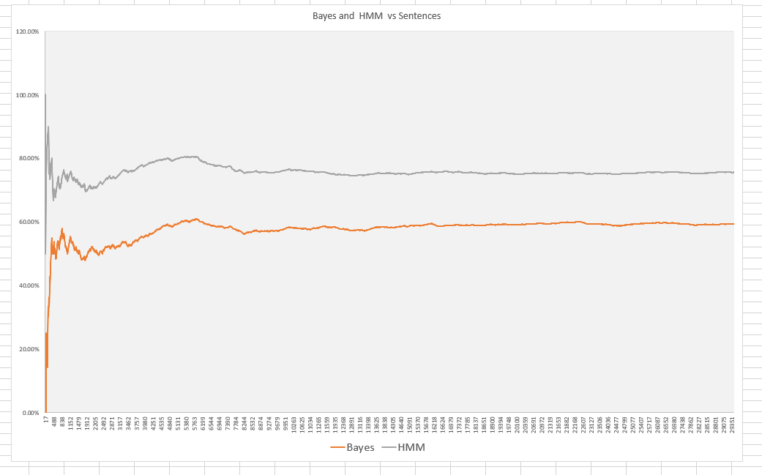
Graph: HMM v/s Bayes for Sentences

Slide 13
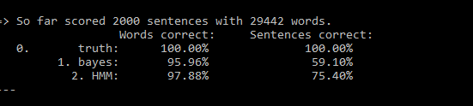
Language: English
Training set Example:
The DET Fulton NOUN County NOUN Grand ADJ Jury NOUN said VERB Friday NOUN
RESULTS:

Slide 14
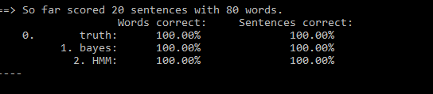
Language : SPANISH
Training set EX:
Vino VERB a PRT la DET playa NOUN

